Slide 1
Parameter-Estimation and Hypothesis-Testing
By
Dr. Anjula Mehto
Assistant Professor
Thapar Institute of Engineering and Technology,
Patiala, Punjab
Email-anjula.mehto@thapar.edu

Slide 2
Parameter Estimation
What is unknown? → Parameters (e.g., mean μ, variance σ², rate λ)
What do we have? → Sample data (observations collected from experiments or real-world processes)
Goal → Estimate parameters from data (using statistical estimation techniques)

Slide 3
Parameter Estimation
Parameter Estimation is a branch of statistics that involves using sample data to estimate the parameters of a distribution.
Or
Parameter estimation is the process of using data to determine the values of parameters in a mathematical model or statistical distribution.

Slide 4
Parameters of Different Distributions
The parameters are the numbers that yield the actual distribution.
Distribution | Parameters
Bernoulli(p) | θ= p
Poisson(λ) | θ= λ
Uniform (a,b) | θ=[a,b]
Normal (μ, σ^2) | θ=[μ, σ^2]

Slide 5
Parameter Estimations Techniques
Method of Moments (MoM)
Maximum Likelihood Estimation (MLE)
Minimum Mean Square Error (MMSE) Estimation

Slide 6
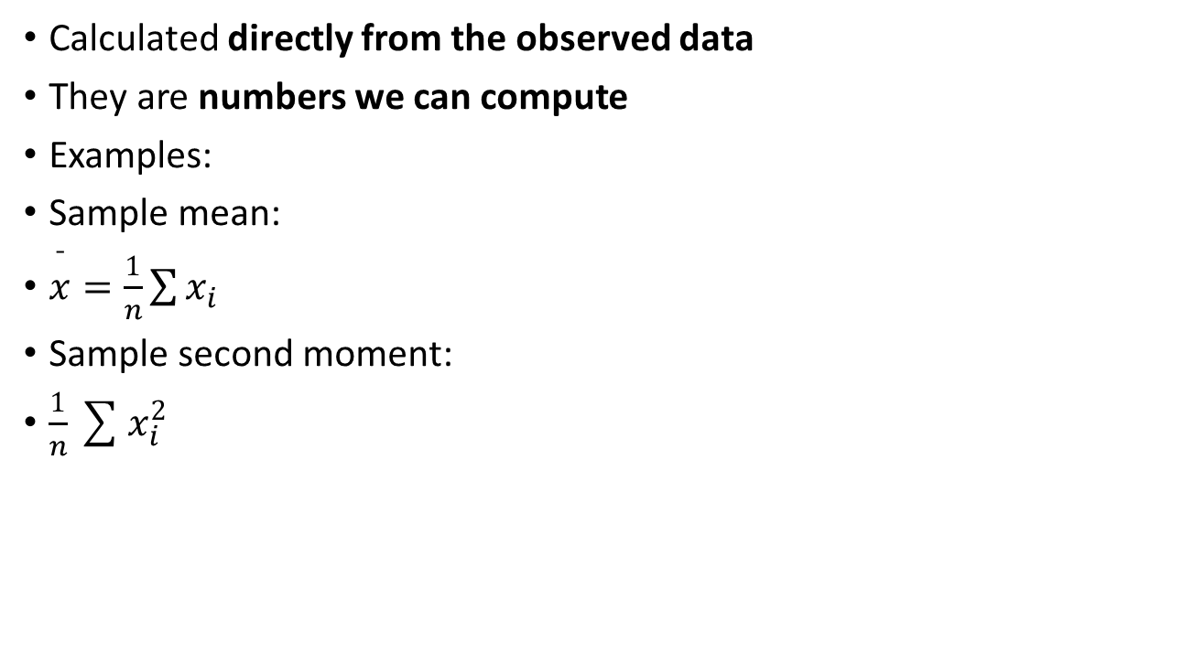
Sample moments
Calculated directly from the observed data
They are numbers we can compute
Examples:
Sample mean:
$\overset{ˉ}{x}=\frac{1}{n}\sum{x_{i}}$
Sample second moment:
$\frac{1}{n}\sum{x_{i}^{2}}$

Slide 7
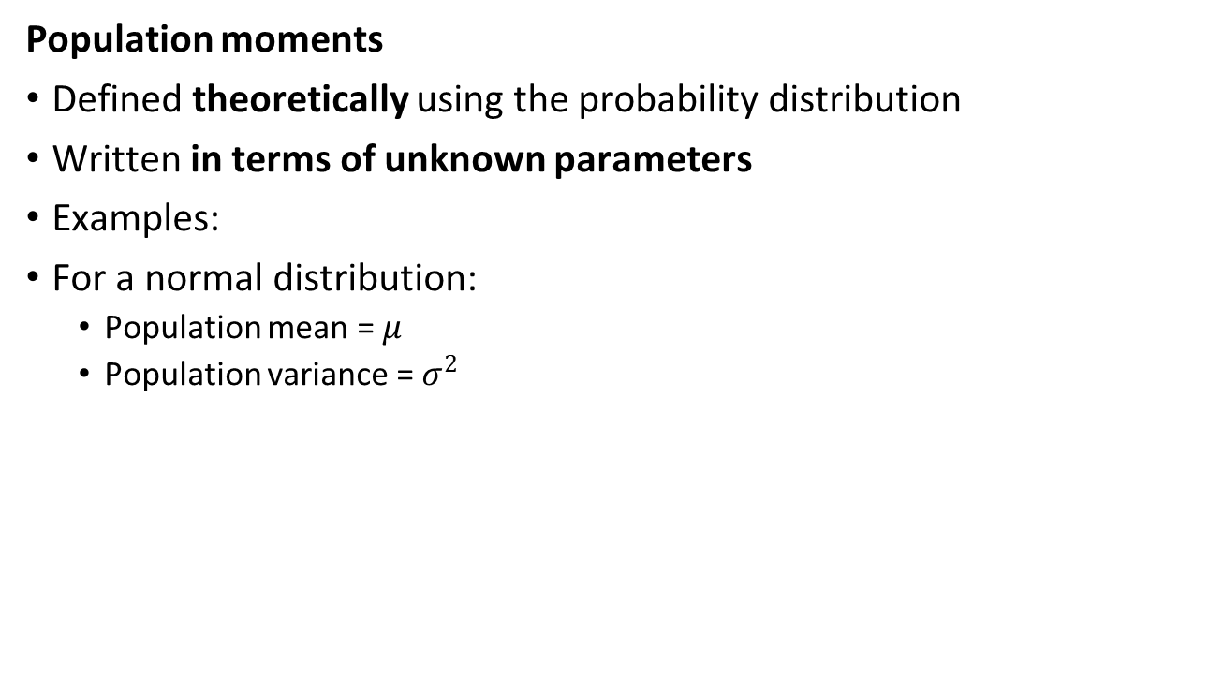
Population moments
Population moments
Defined theoretically using the probability distribution
Written in terms of unknown parameters
Examples:
For a normal distribution:
Population mean = $μ$
Population variance = $σ^{2}$

Slide 8
Method of Moments
Estimating the Moments about population mean (µ).
Involves equating the sample moments of a statistical distribution to the corresponding population moments.
The sample moments are computed from the observed data, while the population moments are expressed in terms of the parameters of the distribution.

Slide 9
Method of Moments
The basic idea of MoM is to estimate the parameters of the distribution by solving a set of equations that equate the sample moments to the population moments.

Slide 10
Method of Moments
Suppose that we take a random sample from a rectangular distribution, i.e., a uniform distribution over [a, b]. The 2 parameters are ‘a’ and ‘b’.
We have to estimate these 2 parameters given a sample of size ‘n’.

Slide 11
Method of Moments
Let (𝑿_𝟏,𝑿_𝟐,…,𝑿_𝒏)be a random sample of size ‘n’ taken from the variable ‘X’.
E(X) = (a + b)/2 = (𝒙_𝟏,+𝒙_𝟐+⋯+𝒙_𝒏)/n= m (say);
This gives us a + b = 2m………….(i)
Var(X)=E(X^2)-(E(X))^2
E(X^2)= Var(X) + (E(X))^2
= (b-a)^2/12 + ((a + b)/2 )^2
= (a^2 + b^2 + ab)/3
=(a^2 + b^2 + ab)/3 = p (say)
This gives us (a^2 + b^2 + ab) = 3p…………(ii)

Slide 12
Method of Moments
Solving (i) and (ii) for a and b gives the estimates using method of moments.
a = m -sqrt(3.p -3.m.m)
b = 2.m –a = m + sqrt(3.p – 3.m.m)

Slide 13
Method of Moments
Let (𝑋1,𝑋2,…,𝑋𝑛)be a random sample of size ‘n’ taken from a Normal Population with parameters: mean𝜃1 and variance 𝜃2.
Estimate these 2 parameters given a sample of size n ?

Slide 14
Method of Moments
For the normal distribution, the population mean and variance are given by:
μ = 𝜃1
σ^2 = 𝜃2
The sample mean and variance can be calculated from the sample:
x̄ = (x_1 + x_2 + ... + x_n) / n
s^2 = ((x_1 - x̄)^2 + (x_2 - x̄)^2 + ... + (x_n - x̄)^2) / (n - 1)

Slide 15
Method of Moments
Setting the sample mean equal to the population mean, we get:
x̄ = 𝜃1
Solving for 𝜃1, we get:
𝜃1 = x̄
Setting the sample variance equal to the population variance, we get:
s^2 = 𝜃2

Slide 16
Method of Moments
Solving for 𝜃2, we get:
𝜃2 = s^2
Therefore, the method of moments estimators for 𝜃1 and 𝜃2 are:
𝜃1 = x̄ = (x_1 + x_2 + ... + x_n)/𝑛 (sample mean)
𝜃2 = 𝑆^2 = ((x_1 - x̄)^2 + (x_2 - x̄)^2 + ... + (x_n - x̄)^2) / (n - 1) (sample variance)

Slide 17
Method of Moments
Method of Moments – Advantages-
Simple
Quick estimates
Limitation
Not always efficient

Slide 18
Maximum Likelihood Estimation
The maximum likelihood estimation (MLE) estimates the population parameters by finding the values that maximize the likelihood function.
For a discrete distribution, maximize the PMF of the data.
For a continuous distribution, maximize the PDF of the data.

Slide 19
Maximum Likelihood Estimation
Let us take a sample of size ‘n’ from an exponential population having the parameter ‘λ’. So, ‘X’ is exponentially distributed with parameter ‘λ’.

Slide 20
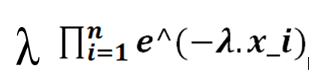
Maximum Likelihood Estimation
Solution-
A sample of size ‘n’ is taken: (𝑿_𝟏,𝑿_𝟐,…,𝑿_𝒏)
Exponential density is:
𝒇(𝒙 ) =𝝀.𝒆^(−𝝀.𝒙), 𝝀>𝟎,𝒙≥𝟎
The density of X_𝒊 is :
𝝀.𝒆(−𝝀.𝒙_𝒊), i=1, 2, ….n.
Joint density of (𝑿_𝟏,𝑿_𝟐,…,𝑿_𝒏)
L(x_1, x_2, …., x_n)=

Slide 21
Maximum Likelihood Estimation
Take natural logarithm.
ln(L(x1, x2, …., xn)) = ln(λ^n* e^((−𝝀.𝒙_𝟏) + (−𝝀.𝒙_𝟐) + ⋯ + (−𝝀.𝒙_𝒏)))
= n*ln(𝝀)+ ((−𝝀.𝒙_𝟏) + (−𝝀.𝒙_𝟐) +⋯ +(−𝝀.𝒙_𝒏))
= n*ln(𝝀)–𝝀 (𝒙_𝟏+ 𝒙_𝟐+..+𝒙_𝒏)
Differentiate this equation with respect to 𝝀, and equate to zero, this will give us the estimator that is obtained using this method of maximum likelihood estimation.

Slide 22


Maximum Likelihood Estimation
Suppose
Z= n*ln(𝝀)–𝝀 (𝒙_𝟏+ 𝒙_𝟐+..+𝒙_𝒏)
n/ 𝝀 - 𝝀 (𝒙_𝟏+ 𝒙_𝟐+..+𝒙_𝒏) = 0
Take (𝒙_𝟏+ 𝒙_𝟐+..+𝒙_𝒏) =
𝝀=𝟏/𝒔𝒂𝒎𝒑𝒍𝒆(𝒎𝒆𝒂𝒏)

Slide 23
Maximum Likelihood Estimation
Q.1 Assume x_1, x_2, x_3……x_n be independent and identically distributed sample from a distribution with probability defined as:
P_(x_i ) (x;θ)=(1-θ)^(x-1).θ,
where θ is the parameter of the distribution. Find the estimator of the parameter using Maximum Likelihood Estimation.

Slide 24
Maximum Likelihood Estimation
Answer-
θ_MLE = n / ∑(x_i)
θ_MLE = 1/mean

Slide 25
Maximum Likelihood Estimation
To find the maximum likelihood estimator of the parameter θ, we need to maximize the likelihood function, which is given by:
L(x_1, x_2, ..., x_n) = ∏[P_(X_i ) (x_i;θ)]
where x_1, x_2, ..., x_n are the observed values of the random variables X_1, X_2, ..., X_n.
Taking the natural logarithm of the likelihood function, we get:
ln L(x_1, x_2, ..., x_n) = ∑[ln P_(X_i )]
= ln (1-θ)^ ∑(x_i-n).θ^n
=( ∑(x_i - n)) ln(1 - θ) ]+ n. ln(θ)

Slide 26
Maximum Likelihood Estimation
To find the maximum of this function, we take the derivative with respect to θ and set it equal to zero:
d/dθ [ln L(x_1, x_2, ..., x_n)]
= d/dθ (∑(x_i - n)) ln(1 - θ) + n. ln(θ)]
= (∑(x_i - n))/(1 - θ).(-1) + n/θ] = 0
Simplifying this expression, we get:
(∑(x_i - n))/(1 - θ)] = n/θ
Solving for θ, we get the maximum likelihood estimator:
θ_MLE = n / ∑(x_i)

Slide 27
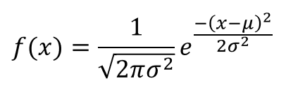
Maximum Likelihood (ML) Estimation
Assignment Question-1
Let (𝑋1,𝑋2,…,𝑋𝑛)be a random sample of size n taken from a Normal Population with parameters: mean𝜃1 and variance 𝜃2. Find the Maximum Likelihood Estimates of these two parameters.

Slide 28
Maximum Likelihood Estimation
Assignment Question-2
Let X_1, X_2 . . . ,X_n be a random sample from B(m, θ) distribution, where θ ∈Θ = (0, 1) is unknown and ‘m’ is a known positive integer. Compute value of θ using the M.L.E.

Slide 29
Maximum Likelihood Estimation
MLE – Why popular
Widely used in ML, signal processing

Slide 30
Minimum Mean Square Error (MMSE) Estimation
Given some information that is related to an unknown quantity of interest (say random variable X) , the problem is to obtain a good estimate for the unknown (variable X) in terms of the observed data (say random variable Y)
In general, our estimate x’ is a function of y:
x’=g(y)

Slide 31
Minimum Mean Square Error Estimation
The error (Ẽ) in our estimate is given by
Ẽ = X- x’= X-g(y)
In MMSE the objective is to minimize the expected value of residual square, where residual is the difference between the true value and the estimated value.
The expected residual square is also known as MSE (Mean Square Error):
E[(X-x’)^2| Y=y] = E[(X-g(y))^2| Y=y]

Slide 32
Procedure to Solve MMSE
Define the estimator
Construct the MSE (Mean Square Error)
Differentiate the MSE with respect to the parameter and set it to zero.
Put the MMSE estimator in step 3 in the MSE expression to find the minimum residual square.

Slide 33
Minimum Mean Square Error Estimation
For simplicity, let us first consider the case that we would like to estimate X without observing anything.
What would be our best estimate of X in that case?
Let `a` be our estimate of X. (Step-1)
Then, the MSE is given by: (Step-2)
h(a) = E[(X-a)^2]
= E[X^2] + a^2 – 2.a.E[X] …Eq(1)

Slide 34
Minimum Mean Square Error Estimation
This is a quadratic function of `a`, and we can find the minimizing value of `a` by differentiation and set it to zero (Step-3)
h′(a)=−2E[X]+2a = 0
Therefore, we conclude the minimizing value of `a` is:
a = E[X]
Put the value of `a` in the Equation (1) (Step-4)

Slide 35
Minimum Mean Square Error Estimation
h(a) = E[X^2] + E[X]^2 – 2.E[X].E[X]
=E[X^2] + E[X]^2 -2 E[X]^2
= E[X^2] - E[X]^2
= Var(X)
Interpretation: The best constant estimator of X is the expected value of X. The minimum MSE using the optimal estimator is the variance of X.

Slide 36
Hypothesis Testing

Slide 37
Hypothesis Testing
Definition- “A hypothesis may be simply defined as a guess. A scientific hypothesis is an intelligent guess”
A statistical hypothesis is an assumption about a population parameter.
Hypothesis testing is a statistical method used to determine whether a hypothesis about a population parameter is supported by the available sample data.
This assumption about the parameter may or may not be true.

Slide 38
Hypothesis Testing
An example of hypothesis testing is testing whether the mean weight of apples in a particular fruit garden is 100 grams.

Slide 39
Types of Hypothesis
In hypothesis testing, we set up two competing hypotheses:
Null Hypothesis (H₀):
Alternative Hypothesis (H₁ or H_{a}):

Slide 40
Null Hypothesis
Null Hypothesis-
It is a statement that there is no significant difference or relationship between two populations or variables.
The null hypothesis, denoted by 𝑯_𝟎.
Example- The null hypothesis is that the mean weight is 100 grams.

Slide 41
Alternative Hypothesis
It is a statement that there is a significant difference or relationship between the two populations or variables.
The alternative hypothesis, denoted by 𝑯_𝟏or 𝑯_𝒂.
There are three types of alternative hypotheses. These are:
(i) 𝑯𝟏: weight≠100
(ii) 𝑯𝟏:weight>100 and
(iii) 𝑯𝟏:weight<100.
We have to consider one of these three hypotheses in a problem.

Slide 42
Alternative Hypothesis
Example-The alternative hypothesis is that the mean weight is not equal to 100 grams.

Slide 43
Decision Errors in Hypothesis Testing
The two hypotheses are complementary to each other.
We accept (or reject) the null hypothesis; this is equivalent to rejecting (or accepting) the alternative hypothesis.
In this process, we make two types of decision errors, namely:
Type I error and
Type II error

Slide 44
Decision Errors in Hypothesis Testing
Type I Error-
When we reject a null hypothesis when it is true.
The probability of committing a Type I error is called the significance level denoted by α.

Slide 45
Decision Errors in Hypothesis Testing
Type II Error-
When we accept a null hypothesis when it is false.
The probability of committing a Type II error is denoted by β.
The probability of not committing a Type II error is called the Power of the test (1-β).

Slide 46
Decision Errors in Hypothesis Testing

Slide 47
Type-1 and Type-2 Error
Example
Suppose a teacher evaluates the examination paper to decide whether a student passes or fails
H₀ -: Student has passed
H₁ -: Student has failed
Type-I error will be the teacher failing the student [rejects H₀ although the student scored the passing marks [H₀ was true]
Type-II error will be the case where the teacher passes the student [do not reject H₀ although the student did not score the passing marks [H₁ is true]

Slide 48
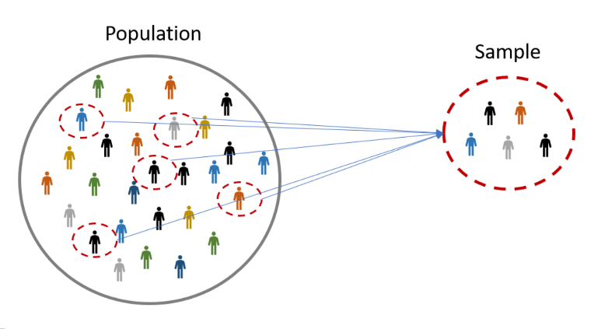
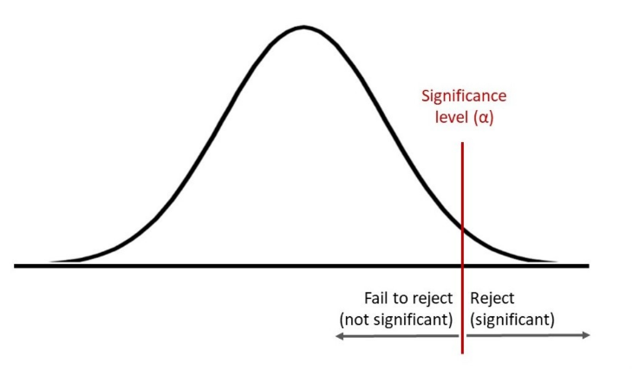
Factors Affecting Type I and Type II Error
Sample Size
Larger sample sizes generally reduce the probability of both Type I and Type II errors.
With larger samples, the estimates tend to be more precise, resulting in more accurate conclusions.
Significance Level (α)
The significance level (α) in hypothesis testing determines the probability of committing a Type I error.
Choosing a lower significance level reduces the risk of Type I error but increases the risk of Type II error, and vice versa.
Most commonly used alpha values are 0.01, 0.05 and 0.1

Slide 49
Level of Significance
The alpha value is a criterion for determining whether a test statistic is statistically significant
In a statistical test, Alpha represents an acceptable probability of a Type I error.
Because alpha is a probability, it can be anywhere between 0 and 1
In practice, the most commonly used alpha values are 0.01, 0.05 and 0.1 which represent a 1%, 5% and 10% chance of a Type I error, respectively (i.e. rejecting the null hypothesis when it is in fact correct)

Slide 50
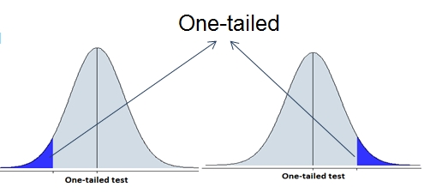
Hypothesis Testing
One-Tailed Test
A test of hypothesis, in which the region of rejection is only on one side of the distribution used for test statistic, is called a one-tailed test.

Slide 51
One-Tailed Test
For example, if we hypothesize that population mean is 12, i.e., null hypothesis is µ = 12.
We consider that the alternative hypothesis is; mean is less than 12, and then we have to employ a one-tailed test.
In this situation, alternative hypothesis shall be µ < 12.
One can see that in some other situation, we may have to consider that µ > 12.

Slide 52
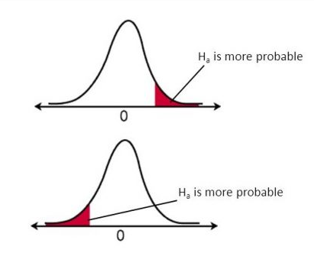
One-Tailed Test
If the sample being tested falls into the one-sided critical area, the alternative hypothesis will be accepted instead of the null hypothesis.

Slide 53
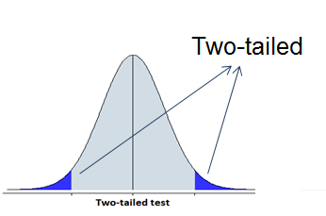
Hypothesis Testing
Two-Tailed Test
A test of hypothesis, in which the region of rejection is on both sides of the distribution used for test statistic, is called a two-tailed test.

Slide 54
Two-Tailed Test
For example, if we hypothesize that population mean is 12, i.e., null hypothesis is µ = 12.
We consider that the alternative hypothesis is; mean is less than 12 or mean is greater than 12, then we have to employ a two-tailed test.
In such a situation, alternative hypothesis shall be µ ≠ 12.

Slide 55
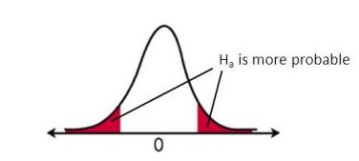
Two-Tailed Test
If the sample being tested falls into the two-sided critical area, the alternative hypothesis will be accepted instead of the null hypothesis.

Slide 56
Steps in Hypothesis Testing
Set up a Hypothesis- State the null and alternative hypotheses.
Setup the level of significance- Significance level is the probability of occurrence of wrong decision. (If not given then consider 5%.)
Choose the appropriate test statistic-
Z-Score (sample size is greater than or equal to 30)
t- Test (sample size is less than 30)
Data that approximately follows a normal distribution

Slide 57
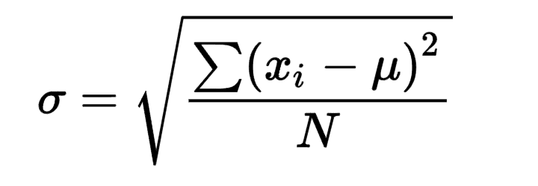
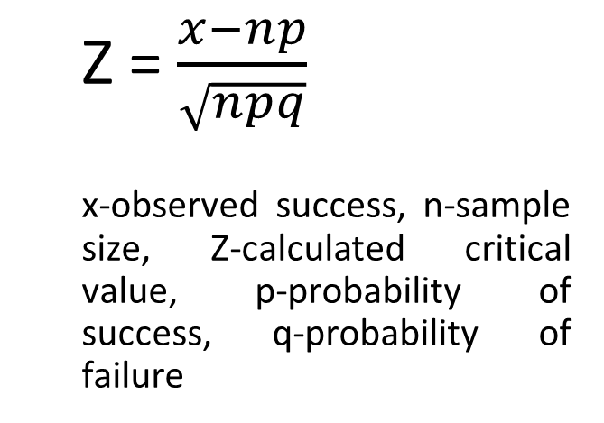
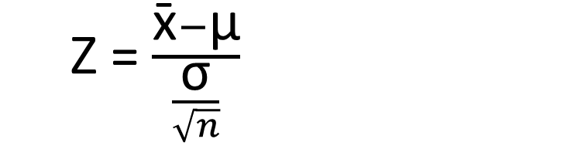
Steps in Hypothesis Testing
4. Computation-
Z-Test-
Z = $\frac{\text{x}\text{̄}−\text{μ}}{\frac{\text{σ}}{\sqrt{n}}}$
Z = $\frac{x−np}{\sqrt{npq}}$
x-observed success, n-sample size, Z-calculated critical value, p-probability of success, q-probability of failure
x̄ is the sample mean, μ is the population mean, σ is the population standard deviation and n is the sample size.

Slide 58
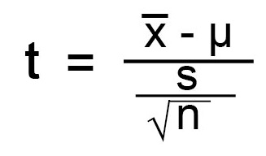
Steps in Hypothesis Testing
4. Computation-
t-Test-
s- standard deviation of the sample, µ - mean of the population, x̄-sample mean

Slide 59
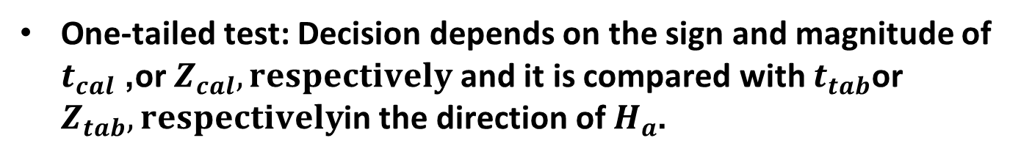

Steps in Hypothesis Testing
Making Decision-
Z_cal > Z_tab, hence (H_0) is rejected- For Z-Test
t_cal > t_tab, hence (H_0) is rejected- For t-Test
Note:
In two-tailed tests, we compare $∣t_{cal}∣$ or $∣Z_{cal}∣$ with $t_{tab}$,or $Z_{tab}, respectively$not the signed value.
One-tailed test: Decision depends on the sign and magnitude of $t_{cal}$, or $Z_{cal}, respectively$and it is compared with $t_{tab}\text{or} Z_{tab}, respectively$in the direction of $H_{a}$.

Slide 60
Z-test vs t-test Assumptions
Z-Test | t-Test
σ known | σ unknown
Large n (≥30) | Small n (<30)

Slide 61
Hypothesis Testing
A coin was tossed 484 times and Head turned up 265 times. Test the hypothesis that the coin is unbiased. The critical Z-values are given.
p | Significance Level | Confidence Level | Two-Tailed Test | One-Tailed Test
0.1 | 10% | 90% | 1.65 | 1.28
0.05 | 5% | 95% | 1.96 | 1.64
0.01 | 1% | 99% | 2.58 | 2.33
0.001 | 0.1 % | 99.9% | 3.29 | 3.10

Slide 62
Hypothesis Testing
Solution-
Step-1 :
H_0 – Coin is unbiased, meaning the probability of getting heads is p=0.5
H_a – Coin is biased meaning the probability of getting heads is not equal to 0.5 (𝑝≠0.5).
Step-2: Setup a significance level- If not given then consider 5%.
Step-3: Setting a Test statistic- Z-Score (sample size is greater than 30)
Z= x-np/sqrt(npq)

Slide 63
Hypothesis Testing
Solution-
Step-4: Calculation
n=484, x=265, p=0.5, q=0.5
Z= x-np/sqrt(npq)
Put the values:
Z= 265-484.(0.5)/sqrt(484.(0.5).(0.5)
Z_cal =2.09
Z_tab = 1.96

Slide 64
Hypothesis Testing
Solution-
Step-5: Make a decision
Check -1: Z_cal > Z_tab, hence (H_0) is rejected.
or
Check-2: The Z_cal (2.09) does not lie in the range of Z_tab (i.e. -1.96 to 1.96)
Hence the Null Hypothesis (H_0) is rejected.
This means there is sufficient statistical evidence at 5% significance level to conclude that the coin is biased.

Slide 65
Hypothesis Testing
In 256 throws of a six faced dice, odd points appeared 122 times. Would you say that the dice is fair at 5% level of significance?

Slide 66
Hypothesis Testing
Solution-
Z_cal= -0.75 < Z_tab
Hence H_0 is accepted.
This means there is sufficient statistical evidence at 5% significance level to conclude that the dice is fair.

Slide 67
Hypothesis Testing
Q.3.1 A professor claims that all the students in the first-year class possess average IQs. Randomly, a test was conducted on thirty students, resulting in a mean IQ is 117. The population mean was 100, and the standard deviation was 27.
Q.3.2 A professor claims that first-year students have higher-than-average Iq. To test this claim, a random sample of 30 students was taken, and their mean IQ was found to be 117. The population mean IQ is known to be 100, with a standard deviation of 27. Conduct a hypothesis test at a 5% significance level to determine if the students have significantly higher IQs than the population average.

Slide 68
Hypothesis Testing
Q.3.1- A professor claims that all the students in the first-year class possess average IQs. Randomly, a test was conducted on thirty students, resulting in a mean IQ is 117. The population mean was 100, and the standard deviation was 27. (Two tailed)
Q.3.2-A professor claims that first-year students have higher-than-average IQs. To test this claim, a random sample of 30 students was taken, and their mean IQ was found to be 117. The population mean IQ is known to be 100, with a standard deviation of 27. Conduct a hypothesis test at a 5% significance level to determine if the students have significantly higher IQs than the population average.
(One tailed)

Slide 69
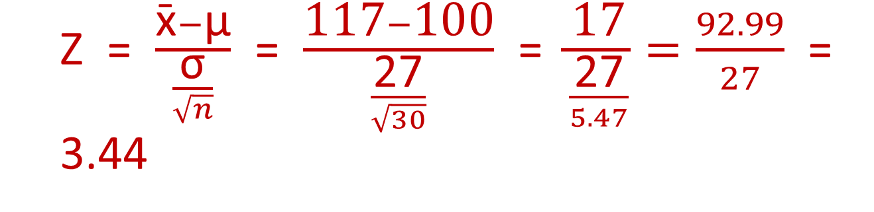
Hypothesis Testing- Question-Solution 3.1
H₀ – All the students in the first-year class possess average Iqs (IQ=100)
H_{a} – All the students in the first-year class do not possess average Iqs (IQ ≠100)
Setup a significance level- If not given then consider 5%.
Z = $\frac{\text{x}\text{̄}−\text{μ}}{\frac{\text{σ}}{\sqrt{n}}}$ = $\frac{\text{117}−\text{100}}{\frac{\text{27}}{\sqrt{30}}}$ = $\frac{\text{17}}{\frac{\text{27}}{5.47}}=\frac{92.99}{27}$ = 3.44

Slide 70
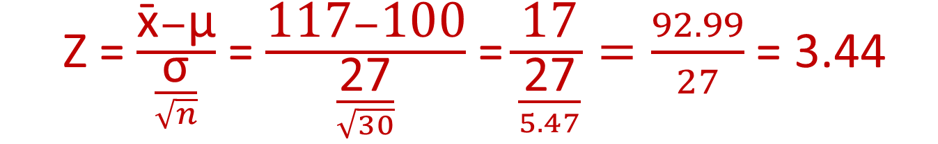
Hypothesis Testing
Solution 3.1- Two tailed test
Z_{Cal} = 3.44
Z_{Tab} =1.96 (Value from the Table given in question 1)
Z_{cal} > Z_{tab}, hence (H₀) is rejected.
This means there is sufficient statistical evidence at 5% significance level to conclude that the first-year class do not possess average IQs.
Z = $\frac{\text{x}\text{̄}−\text{μ}}{\frac{\text{σ}}{\sqrt{n}}}$ = $\frac{\text{117}−\text{100}}{\frac{\text{27}}{\sqrt{30}}}$ = $\frac{\text{17}}{\frac{\text{27}}{5.47}}=\frac{92.99}{27}$ = 3.44

Slide 71


Hypothesis Testing
Solution 3.2
Step 1: State the hypotheses
The claim is “higher-than-average IQs”.
$$H_{0}:μ=100$$
$$H_{a}:μ>100 \text{(}\text{Right}\text{−}\text{tailed} \text{test}\text{)}$$
Do all the steps from 1 to 5 (in the MST)
Step 4: Decision
$$Z_{cal}>Z_{tab}$$
$$3.45>1.645$$
There is sufficient statistical evidence at the 5% level of significance to conclude that first-year students have significantly higher IQs than the population average.

Slide 72
Hypothesis Testing
The manufacturer of a certain make of Thermometer claims that his thermometers have a mean life of 20 months. A random sample of 7 such thermometers gave the following values. Life of thermometers in months: 19, 21, 25, 16, 17, 14, 21. Can you regard the producer’s claim to be valid at 1% level of significance? Given that t_tab= 3.707.

Slide 73

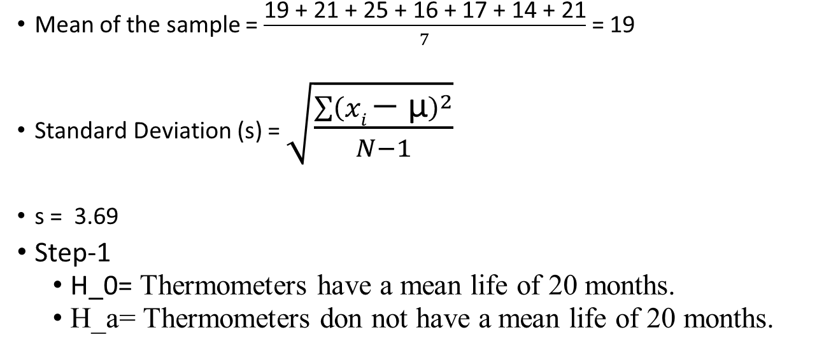




Solution- (Two Tailed Test)
19, 21, 25, 16, 17, 14, 21
Mean of the sample = $\frac{\text{19 }\text{+ }\text{21 }\text{+ }\text{25 }\text{+ }\text{16 }\text{+ }\text{17 }\text{+ }\text{14 }\text{+ }\text{21}}{7}$ = 19
Standard Deviation (s) = $\sqrt{\frac{\sum{{\left(xi \text{− }\text{μ}\right)}^{2}}}{N−1}}$
s = 3.69
Step-1
H_0= Thermometers have a mean life of 20 months.
H_a= Thermometers don not have a mean life of 20 months.

Slide 74
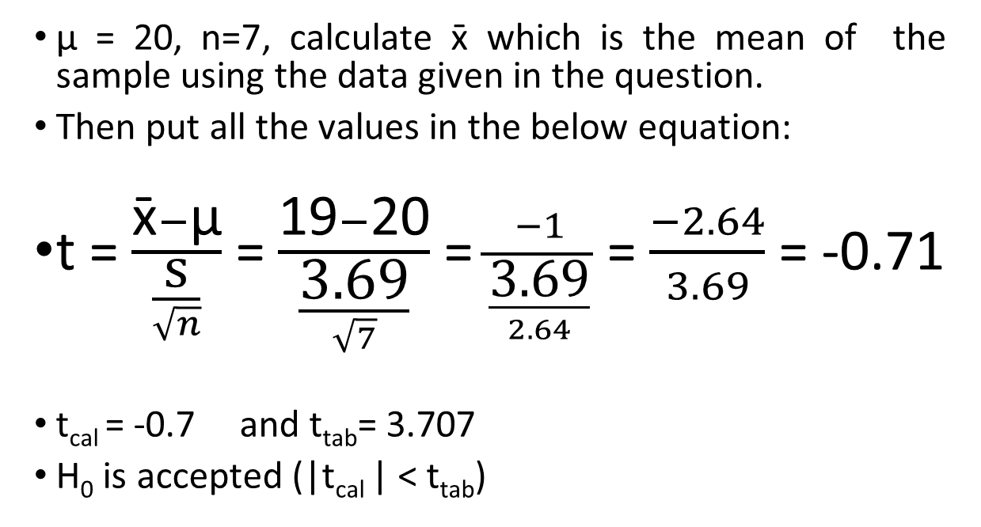
Hypothesis Testing-Solution
µ = 20, n=7, calculate x̄ which is the mean of the sample using the data given in the question.
Then put all the values in the below equation:
t = $\frac{\text{x}\text{̄}−\text{μ}}{\frac{\text{s}}{\sqrt{n}}}$ = $\frac{\text{19}−\text{20}}{\frac{\text{3.69}}{\sqrt{7}}}$ = $\frac{−1}{\frac{\text{3.69}}{2.64}}$ = $\frac{−2.64}{3.69}$ = -0.71
t_{cal} = -0.7 and t_{tab}= 3.707
H₀ is accepted (|t_{cal} | < t_{tab})
This means there is sufficient statistical evidence at 1% significance level to conclude that thermometers have a mean life of 20 months.

